Slide 1

PhoneGap Cordova Training Day 2

Slide 2

Mobile Development using Cordova
Table of Contents
JqueryMobile Basics
Jquery Mobile - Style class manipulation
DOM Manipulation

Slide 3
Building Cordova apps with jQuery Mobile
Phone gap is an HTML5 app platform
It allows developers to develop native application with web technologies and get access to API’s
Applications are build as normal HTML pages and packed up to run as a native application within the UIWebView or Web View
Requirement:
Download jQuery, jQuery Mobile Library, and jQuery Mobile Stylesheet
Place the below libraries in each HTML file to utilize the jquery mobile framework
To Enable Jquery Mobile CSS
<link rel="stylesheet" href="../jqueryMobile-1.4.3/css/jquery.mobile-1.4.3.min.css" />
<link rel="stylesheet" href="../jqueryMobile-1.4.3/css/jquery.mobile.theme-1.4.3.min.css" />
To Enable Jquery Mobile
<script type="text/javascript" src="../js/jquery-1.8.2.js"></script>
<script type="text/javascript" src="../cordova.js"></script>
<script type="text/javascript" src="../jqueryMobile-1.4.3/js/jquery.mobile 1.4.3.min.js"></script>
First link the JQuery library and there after jQuery mobile libraries(Strictly follow the same structure to add the framework)
If we have linked the jQuery Mobile style sheet, our page has also been styled up without the need of additional style rules.

Slide 4
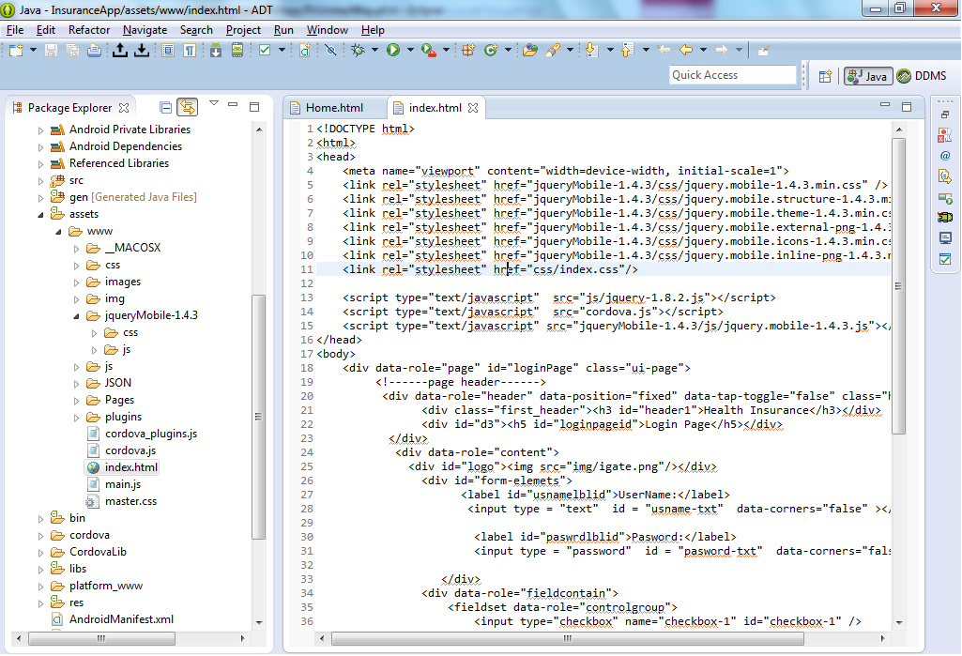

Slide 5
Building Cordova apps with jQuery Mobile
Mobile Page Structure
<!DOCTYPE html>
<html>
<head>
<title>Page Title</title>
<meta name="viewport" content="width=device-width, initial-scale=1">
<link rel="stylesheet" href="http://code.jquery.com/mobile/1.2.1/jquery.mobile-1.2.1.min.css" />
<script src="http://code.jquery.com/jquery-1.8.3.min.js"></script>
<script src="http://code.jquery.com/mobile/1.2.1/jquery.mobile-1.2.1.min.js"></script>
</head>
<body>
...content goes here...
</body>
</html>

Slide 6
Building Cordova apps with jQuery Mobile
content="width=device-width, initial-scale=1“ - the width will be set to the pixel width of the device screen. These settings do not disable the user's ability to zoom the pages.
Inside the body: Pages
<div data-role="page">
<div data-role="header">...</div>
<div data-role="content">...</div>
<div data-role="footer">...</div>
</div>
Note:
If your body contains no data-role="page" divs, jQuery Mobile wraps the entire contents of the body within a page div as explained above. jQuery Mobile is using jQuery's wrapAll() method to do this which looks for any script tags inside the content being wrapped, and loads each script source via XHR. If scripts are present in the body, the browser ends up loading them twice. We therefore strongly recommend that jQuery Mobile documents with scripts in their body also contain a div with data-role="page".
http://demos.jquerymobile.com/1.2.1/docs/pages/page-anatomy.html
http://www.w3schools.com/jquerymobile/jquerymobile_examples.asp

Slide 7
Building Cordova apps with jQuery Mobile
<!DOCTYPE html>
<html>
<head>
<title>Page Title</title>
<meta name="viewport" content="width=device-width, initial-scale=1">
<link rel="stylesheet" href="http://code.jquery.com/mobile/1.2.1/jquery.mobile-1.2.1.min.css" />
<script src="http://code.jquery.com/jquery-1.8.3.min.js"></script>
<script src="http://code.jquery.com/mobile/1.2.1/jquery.mobile-1.2.1.min.js"></script>
</head>
<body>
<div data-role="page">
<div data-role="header">
<h1>Page Title</h1>
</div><!-- /header -->
<div data-role="content">
<p>Page content goes here.</p>
</div><!-- /content -->
<div data-role="footer">
<h4>Page Footer</h4>
</div><!-- /footer --></div><!-- /page -->
</body> </html>

Slide 8
Few tips that aren't specifically related to PhoneGap:
Recommend disabling the pushState feature for installed apps because there are edge cases where this feature can cause unexpected navigation behavior and since URLs aren't visible in a webview, it's not worth keeping this active in these situations.
Android enforces a timeout when loading URLs in a webview which may be too short for your needs. You can change this timeout by editing a Java class generated by the Eclipse plugin for Android:
super.setIntegerProperty("loadUrlTimeoutValue", 60000);
Avoid underscores in files and folders because Phonegap may fail to load the contained files in Android. This is a known issue.
Try animation-fill-mode to reduce blinky transitions but beware that we're found that certain devices like the Nexus 7 run animations very slowly when this CSS property is in play. We recommend targeting this carefully and testing thoroughly to ensure that it doesn't impact smoothness

Slide 9
JqueryMobile Basics

Slide 10
Introduction
jQuery Mobile is a framework for creating mobile web applications.
jQuery Mobile provides a set of touch-friendly UI widgets and an AJAX-powered navigation system to support animated page transitions.
Develop pages primarily using markup driven with minimal or no JavaScript.
jQuery Mobile provides support for different input methods and events: touch, mouse, and cursor focus-based user input methods.
Use a single HTML document with multiple embedded pages.

Slide 11
Introduction
jQuery Mobile leverages the latest HTML5, CSS 3, and JavaScript, not all mobile devices provide such support.
The framework is lightweight with an overall size (minified and zipped for Version 1.0.1) of 24KB for the JavaScript library, 7KB for the CSS, plus some icons.
Lightweight size and minimal image dependencies for speed.
jQuery Mobile works on all popular smartphones and tablets.
Responsive design techniques and tools allow the same underlying codebase to automatically scale from smartphone to desktop-sized screens

Slide 12
Introduction – Jquery Mobile Sample
<!DOCTYPE html>
<html>
<head>
<title>Page Title</title>
<meta name="viewport" content="width=device-width, initial-scale=1">
<link rel="stylesheet"
href="http://code.jquery.com/mobile/1.1.0/jquery.mobile-1.1.0.min.css" />
<script type="text/javascript" src="phonegap.js"></script>
<script src="http://code.jquery.com/jquery-1.7.1.min.js"></script>
<script
src="http://code.jquery.com/mobile/1.1.0/jquery.mobile-1.1.0.min.js"></script>
<script type="text/javascript" src="js/index.js"></script>
</head>
<body>
<div data-role="page">
<div data-role="header">
<h1>Show My Contacts</h1>
</div><!-- /header -->
<div data-role="content">
<div id="contactsList">
</div>
</div><!-- /content -->
</div><!-- /page -->
</body> </html>

Slide 13
Introduction – Jquery Mobile Sample
document.addEventListener("deviceready", onDeviceReady, false);
function onDeviceReady() {
// find all contacts with ‘Thara' in any name field
var options = new ContactFindOptions();
options.filter = “Thara";
options.multiple = true;
var fields = ["displayName", "name", "phoneNumbers"];
navigator.contacts.find(fields, onSuccess, onError, options);
}

Slide 14
Introduction – Jquery Mobile Sample
function onSuccess(contacts) {
for(var i = 0; i < contacts.length; i++) {
var html = '<div data-role="collapsible" data-inset="false">';
html += '<h2>' + contacts[i].displayName + '</h2>';
html += '<ul data-role="listview">'
var contact = contacts[i];
for(var j = 0; j < contact.phoneNumbers.length; j++) {
html += '<li>' + contact.phoneNumbers[j].type +
": " + contact.phoneNumbers[j].value + '</li>';
}
html += '</ul></div>';
$('#contactsList').append(html);
}
$('[data-role=collapsible]').collapsible().trigger('create');
}
function onError(contactError) {
alert('onError!');
}

Slide 15
Jquery Mobile - Style class manipulation

Slide 16
Styles
CSS properties that normally include a hyphen need to be camelCased in JavaScript.
By means of .css() method styling can be done.
selector.css( PropertyName, PropertyValue );
For example $( "h1" ).css( "font-size" , “100px”) will set the font size as 100px.Here for header h1 the font-size will be set as 100px.

Slide 17
Styles
jQuery library supports nearly all of the selectors in Cascading Style Sheet (CSS).
selector.css( {key1:val1, key2:val2....keyN:valN})
For setting multiple properties :
$( "h1" ).css({ fontSize: "100px", color: "red“ });
The width( val ) and height( val ) method can be used to set the width and hieght respectively of any element.

Slide 18
Styles
position() - Gets the top and left position of an element relative to its offset parent.
<script>
var p = $( "p:first" );
var position = p.position();
$( "p:last" ).text( "left: " + position.left + ", top: " + position.top );
</script>
scrollLeft() - Gets the scroll left offset of the first matched element.
<script>
var p = $( "p:first" );
$( "p:last" ).text( "scrollLeft:" + p.scrollLeft() );
</script>

Slide 19
Styles
scrollTop() - When a value is passed in, the scroll top offset is set to that value on all matched elements.
<script>
var p = $( "p:first" );
$( "p:last" ).text( "scrollTop:" + p.scrollTop() );
</script>
addClass() - Adds one or more classes to the selected elements.
$( "p" ).addClass( "myClass yourClass" );
It simply adds the class, appending it to any which may already be assigned to the elements.

Slide 20
Styles
removeClass() - Removes one or more classes from the selected elements.
$( "p" ).removeClass( "myClass noClass" ).addClass( "yourClass" );
toggleClass() - Toggles between adding/removing classes from the selected elements.
$( "div.foo" ).toggleClass(function() {
if ( $( this ).parent().is( ".bar" ) ) {
return "happy";
} else {
return "sad";
}
});

Slide 21
Styles
innerWidth() - method returns the width of an element (includes padding).
$( "p:last" ).text( "innerWidth:" + p.innerWidth() );
outerWidth() - method returns the width of an element (includes padding and border).
$( "p:last" ).text("outerWidth:" + p.outerWidth() +" , outerWidth( true ):" + p.outerWidth( true ) );

Slide 22
Styles
outerHeight() - method returns the height of an element (includes padding and border).
<script>
var p = $( "p:first" );
$( "p:last" ).text("outerHeight:" + p.outerHeight() +" , outerHeight( true ):" + p.outerHeight( true ) );
</script>

Slide 23
DOM Manipulation

Slide 24
DOM Manipulation
DOM - Document Object Model
One very important part of jQuery is the possibility to manipulate the DOM.
Mechanism for representing and interacting with your HTML, XHTML or XML documents
It allows you to navigate and manipulate your documents through a programming language
jQuery comes with a bunch of DOM related methods that make it easy to access and manipulate elements and attributes.

Slide 25
DOM Manipulation
JQuery can read and manipulate the DOM of your HTML page using a set of simple methods. These methods are:
text()
html()
val()
attr()
removeAttr()
prepend()
append()
before()
after()

Slide 26
DOM Manipulation
insertBefore()
insertAfter()
wrap()
replaceWith()
replaceAll()
remove()
empty()
clone(), etc,.
Each of these functions is described in the sections below.

Slide 27
DOM Manipulation - methods
text() - method can read or write the text inside a given HTML element.
<div class="demo-container">
<div class="demo-box">Demonstration Box</div>
<ul>
<li>list item 1</li>
<li>list <strong>item</strong> 2</li>
</ul>
</div>
The code $( "div.demo-container" ).text() would produce the following result:
Demonstration Box list item 1 list item 2

Slide 28
DOM Manipulation - methods
html() - method works much like the text() method, except the method returns the HTML of a given element, not just the text.
val() - method is used to get and set the value of form fields.
// Get the value from a dropdown select
$( "select.foo option:selected").val();
// Get the value from a dropdown select even easier
$( "select.foo" ).val();
// Get the value from a checked checkbox
$( "input:checkbox:checked" ).val();
// Get the value from a set of radio buttons
$( "input:radio[name=bar]:checked" ).val();

Slide 29
DOM Manipulation - methods
attr() - function can read and write attributes of HTML elements.
removeAttr() - method is used to remove an attribute from an HTML element
prepend() - method inserts new HTML into the beginning of the selected HTML element. The new HTML is concatenated with the HTML the element had already.
$( ".inner" ).prepend( "<p>Test</p>" );
Each <div class="inner"> element gets new content as Test

Slide 30
DOM Manipulation - methods
append() - method inserts new HTML into the end of the selected HTML element. The new HTML is concatenated with the HTML the element had already.
before() - method inserts HTML before the selected element (outside the element).
replaceWith() - method replaces the selected HTML element with a new one. The new HTML element is passed as parameter to the replaceWith() method.

Slide 31
DOM Manipulation - methods
wrap() - method can wrap the selected HTML element in another HTML element.
<div class="container">
<div class="inner">Hello</div>
<div class="inner">Goodbye</div>
</div>
$( ".inner" ).wrap( "<div class='new'></div>" );
The new <div> element is created on the fly and added to the DOM. The result is a new <div> wrapped around each matched element
<div class="container">
<div class="new">
<div class="inner">Hello</div>
</div>
<div class="new">
<div class="inner">Goodbye</div>
</div>
</div>

Slide 32
DOM Manipulation - methods
remove() - method removes the selected HTML element from the DOM.
empty() - method removes all child elements of the selected HTML element.
parent() - Get the parent of each element in the current set of matched elements, optionally filtered by a selector.
has() – Reduce the set of matched elements to those that have a descendant that matches the selector or DOM element.
http://jquery.com/
http://jquerymobile.com/

Slide 33

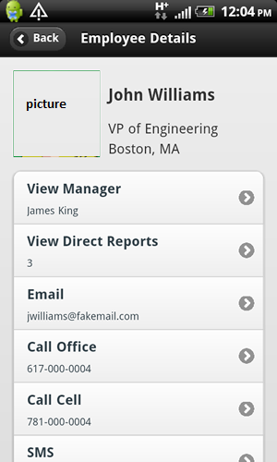
Daily Assignment – Day 2
Prepare a sample application which displays the below information on ios & Android using jquery mobile & Phonegap
1. Display EmployeeList 2. When click on arrow on right move to EmployeeDetails screen

